Slide 1
Common Knowledge in Research
Version 2.0 by Sherry in June 2021
Notes
The slides CANNOT cover all the common knowledge you need to know for research.
Please READ the policies and guidelines of the conference websites before your paper submission BY YOURSELF. You can learn a lot. DO NOT BE LAZY~
Please attend PDEV6770 and LANG5001. Keep all the things you have learned in mind.

Slide 2
What You Need to Have Before Conducting PhD in Database Area?
Technical Skills
Programming languages such as C, C++, Java, Python, R…
Basic Linux skills
Theoretical Background
Knowledge about NP optimization problems
e.g., A compendium of NP optimization problems
e.g., Computers and intractability: a guide to the theory of NP-completeness
e.g., COMP 5711 and COMP 5712 in HKUST
Knowledge about data structures and advanced algorithms
e.g., COMP3711 in HKUST
e.g., Graph Theory
Maths and English are very important!
Notes:
Pre-requirement in CS PhD (Chinese): https://github.com/fangvv/Homepage/blob/master/index.md

Slide 3
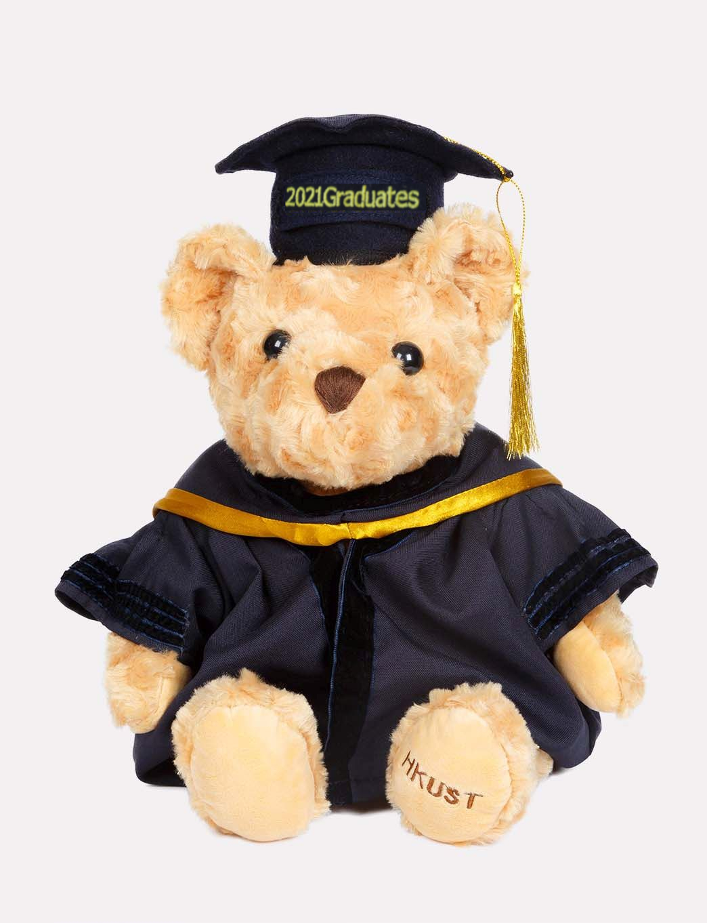
A PhD in HKUST

Slide 4
Suggestions about Taking PhD in CSE in HKUST…
Research is our major duty in PhD, so remember to read papers and conduct research every week!
1-2 courses will be good enough in one semester (otherwise, you may have no time for research 🥵)
According to most people, UG courses are usually more difficult than PG courses.
I think the following plan may be suitable for most people (especially in the semester when you have TA duties):
1 PG course
1 UG course + 1 PG course
2 PG courses
I took 3 PG courses in my first semester. I almost died in the final week. 😅

Slide 5
Our Weekly Meeting Routine
One small group meeting
More discussion is better! Asking questions is not stupid.
Everyone shares their research progress
One large group meeting
1-2 people from each group presents the details of his/her current work
Only about research. Do not need to talk about our homework/courses/TA duties…

Slide 6
About Our Group!
Blockchain: https://www.cse.ust.hk/blockchain/index.html
DB for AI
Graph: http://www.cse.ust.hk/biggraph/index.html
Knowledge Graph (KG): https://www.cse.ust.hk/knowledgegraph/home.html
Machine Learning (ML): https://www.cse.ust.hk/dbml
Spatial Crowdsourcing (STC): https://www.cse.ust.hk/stc

Slide 7
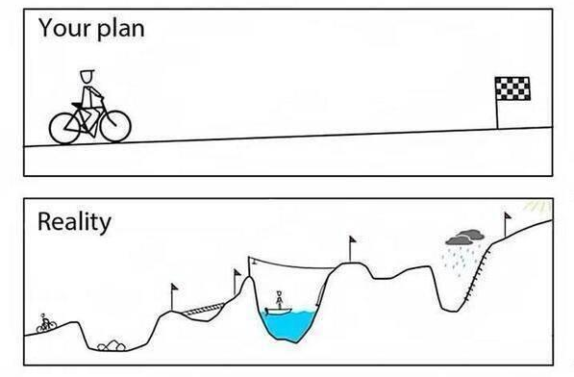
General Research Suggestions for PhD
May not be suitable for every PhD in the world, just some experience from my friends and me…

Slide 8
How to Find Interesting Topics?
Choose one method in 1/2/3/4 to find a general topic, then use method 5 to inverstigate a smaller topic.
Search for the surveys in certain topics in recent 3 years
Look for the proceedings in DB/DM top conferences in recent 3 years
SIGMOD/VLDB/ICDE/KDD/ICDM/TKDE/VLDBJ….
Find the hot topics and tutorials from GitHub (the awesome xxx/must-read-papers)
GNNPapers: https://github.com/thunlp/GNNPapers
Awesome-KGQA: https://github.com/BshoterJ/awesome-kgqa
KG group https://github.com/heathersherry/Knowledge-Graph-Tutorials-and-Papers
Follow the works published in famous researchers in this area
e.g., Jure Leskovec https://cs.stanford.edu/people/jure/
Read one paper in your interested topic (from top conference), then
Read its related works to know the state-of-the-arts techniques
Read the papers that cite this paper via Google Scholar
In this way, you can find the small “paper community” that study this topic

Slide 9
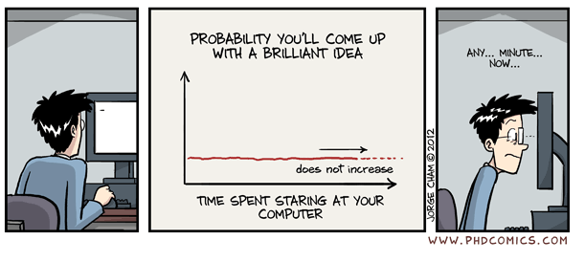
How to Start Your Work?

Slide 10
How to Start Your Work?
Meanwhile, write down your thoughts and details in slides or latex (in case you forget)
Choose your favorite topic
Find the datasets used in most papers in this topic
Conduct some experiments to reproduce the results of state-of-the-arts techniques
Find the limitations in these experimental results, and conduct an analysis:
What causes these bad cases? Are these bad cases common in most scenarios?
Why is this step so slow? Is there any efficiency issue in the code?
Motivated by your analysis, start to think about whether there is a research problem:
Can this be solved by any other existing method (in any area)? 😅
Can this be solved by an engineering combination of other existing methods? 😅
If not, start to think whether you can formulate this as a research problem 🤩
Implement your naïve solution and start to improve it…

Slide 11
How to Present Ideas to Other Researchers?
Actually, this is the content of your Introduction.
Describe the problem
Is this problem important? Or just some rare cases in real-world scenarios? Is there any statistics or existing publication that proves its importance? Do you have motivating examples?
Present a summary (instead of details) of the solutions from the previous works
What are the drawbacks of these previous works?
Present the general idea of your solution
Why is it better than the previous works?
Present the technical challenges (2~3 challenges) of your solution
Is it just an engineering modification or combination of the previous works?
If parts of your work are based on any previous work, do you clarify the border between previous works and your contributions?
Use a clear and simple motivating example (better with figures) to illustrate your idea!
Notes: We present the idea to our supervisors and group members to seek for comments and advices. They can give their opinions whether your idea is feasible and convincing. DO NOT ask them to directly give you the complete solution. Otherwise, they can obtain another PhD degree by themselves based on your topic.

Slide 12
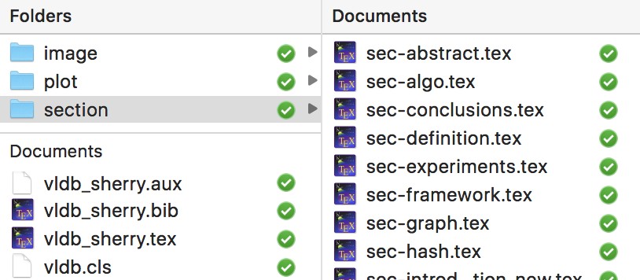
Which Tools to Use to Write Papers?
Paper Writing: LATEX
Tutorial: http://www.docs.is.ed.ac.uk/skills/documents/3722/3722-2014.pdf
Useful applications: TextStudio https://www.texstudio.org/
Collaboration with other people
GitHub
Dropbox
Overleaf
TIPS: Organize the files in folders, so that you and your collaborators can work on different parts of the paper without conflict.

Slide 13
How to Write Good Papers?
Good tool for typo and grammar checking:
Google online doc
Paper writing is as important as actual works:
Treat your paper as a textbook that will be published instead of an experimental report or a course report.
If you are not a native English speaker and this is the first time you submit a research paper, it is better to revise each section AT LEAST THREE TIMES.
Check the spelling and grammar BY YOURSELF before passing the paper to your coauthors and supervisors. DO NOT use them as Grammarly.
Ask your friends for help. Let them read your paper and tell you which parts they cannot understand. Revise that parts by yourself until everyone understands everything in the introduction and abstract. The key idea of a good paper should be understood by any undergraduate student.
Reviewers may accept your paper if they understand your idea and solution CLEARLY.
They will definitely NOT accept your paper if it looks complicate and hard to follow.

Slide 14
How to Write Good Papers?
Suggestions:
Use good notations. You need to decide which notations to use at the very beginning of your work. DO NOT wait until you finish all the writing. DO NOT use too many notations in one paper, it confuses the readers.
Use examples (with figures) to demonstrate your algorithms or workflows.
Be concreate (especially in experiment discussion). Concreate numbers (e.g., “87.3%”) are ALWAYS BETTER than “many/a large number of/a few/largely improve/slightly improve”.
Explain every technical phrase (e.g., “global similarity”) when it appears in your text for the first time.
Use vector graphics (pdf, svg, eps…) instead of raster graphics (jpeg, gif, …).
Avoid redundant patterns/words/sentences in the text. Try to use synonyms and different sentence patterns to express the same meaning.
Make the “a/an, the, (plural)” in your paper correct!!! Otherwise it always confuses your readers!
“We work on a KB.” → We work on one KB. No specific.
“We work on KBs.” → We work on all KBs. No specific.
“We work on the KB.” → We only work on the specific KB that we mentioned above.
P.S. You can send your draft to the grammar tutor of our department (dalton AT cse.ust.hk). She will check your grammar and send some feedbacks after one week. However, she is not an expert in understanding your technical details. You need to check most of the technical parts BY YOURSELF.

Slide 15
What is Important in Paper Format?
Capitalize the titles of your sections and subsections
Use bullet points (\begin{itemize}), bold fonts, and italic fonts to highlight the important parts
Leave a space between words and citation, e.g., “Kruskal’s algorithm [1]”, not “Kruskal’s algorithm[1]”. Use “~\cite{}” in LaTex.
In the References section, make sure each citation has the same format
M. C. Phan, A. Sun, Y. Tay, J. Han, and C. Li. Pair-linking for collective entity disambiguation: Two could be better than all. Transactions on Knowledge and Data Engineering, 31(7):1383–1396. IEEE, 2018.
Z. Fang, Y. Cao, Q. Li, D. Zhang, Z. Zhang, and Y. Liu. Joint entity linking with deep reinforcement learning. The World Wide Web Conference, pages 438–447. ACM, 2019.
Choose either style. Use one style for all the papers.
M. C. Phan, A. Sun, Y. Tay, J. Han, and C. Li. Pair-linking for collective entity disambiguation: Two could be better than all. TKDE, 31(7):1383–1396. IEEE, 2018.
Z. Fang, Y. Cao, Q. Li, D. Zhang, Z. Zhang, and Y. Liu. Joint entity linking with deep reinforcement learning. WWW, pages 438–447. ACM, 2019.
DO NOT just copy and paste the BibTex from Google Scholar. Most BibTex from Google Scholar is messy. Check and Fix it by yourself. DO NOT BE LAZY.
One suggestion is to directly use the BibTex from DBLP, which is more standard.

Slide 16
What Conferences/Journals Do We Target At?
Conferences (you need to be aware of the deadlines every year):
SIGMOD (2 ddls, usually one in June/July, the other in September/October), 12 pages
PODS (2 ddls, usually one in June, the other in December)
VLDB (ddl on 1st of each month ), 12 pages
A rejected paper is only allowed to be resubmit after 12 months
ICDE (2 ddls, usually one in June/July, the other in October/November), 12 pages with references
KDD (February), 9+2 pages
Other top conferences in ML, such as ICML, NeurIPS, ICLR…
Journals:
TKDE, VLDBJ, TODS…
Suggestions:
Schedule a recycle plan. You need to know the notification date of each conference every year. If a paper is rejected from the first submission, estimate the time to revise the paper and prepare to submit it to one of the next deadlines.
Check the conference websites for new publications and keynotes, to follow the hot topics. e.g., https://sigmod2020.org/sigmod_research_list.shtml

Slide 17
What is Important During Paper Submission?
Fill in “Domain Conflict”:
ust.hk; connect.ust.hk; cse.ust.hk
Do not enter public webmail providers as institution domains
And the domains of your coauthors
DO NOT miss anyone!! This is important in academic honesty.

Slide 18
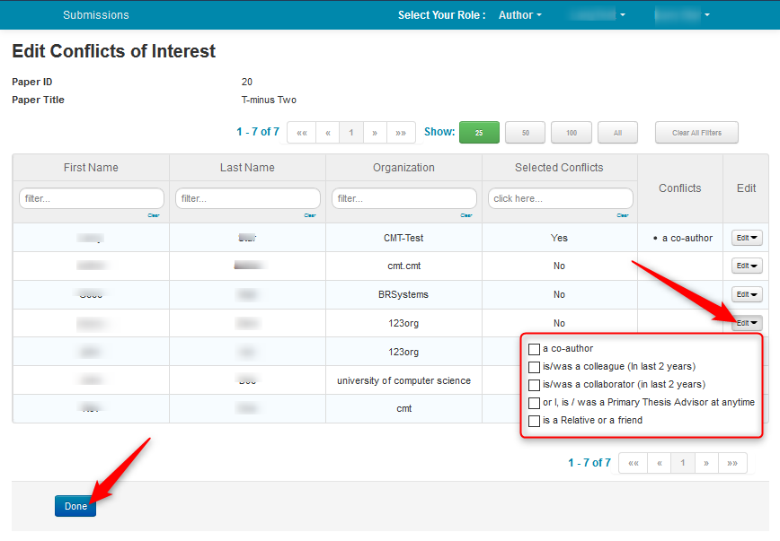
What is Important During Paper Submission?
Fill in the Conflict of Interest List (COI list):
Add all the recent colleagues/recent collaborators/thesis advisor/friend/relatives of all the coauthors. You may need to read their Google Scholar or DBLP.
For fairness, these people will not have chance to bid and review your paper because you are too familiar with each other.
Ask your supervisor, your senior and your coauthors if you do not know who to fill in.
DO NOT miss anyone!!! This is important in academic honesty.

Slide 19
Some Common Knowledge of Paper Reviews
Mode of Reviews
Single-blind: The reviewers can view the names of author, but the author does not know who the reviewers are. (e.g., VLDB, ICDE, applied science track of KDD)
Double-blind: The reviewers cannot view the names of author, and vice versa. (e.g., SIGMOD, research track of KDD)
Triple-blind: The reviewers and handling editors (PC chairs) cannot view the names of author, and vice versa. (e.g., ICDM)
Open review: The paper review is public. Anyone can review and comment the paper. (e.g. ICLR) https://iclr.cc/archive/www/doku.php%3Fid=iclr2017:faq.html)
DO NOT submit low-quality papers to single-blind conferences. This damages the reputation of you and your coauthors.
Notes:
Check the conference websites for the modes of reviews every time before your submission.
For conferences in double-blind and triple-blind, you should not leak any information about your identities in the paper. DO NOT mention your name, your affiliations, your github address, the arXiv version of your paper (if there is any).
Different conferences have different rules in different years. Make sure you read EVERY WORD in the submission guideline. DO NOT BE LAZY!!

Slide 20
Some Common Knowledge of Paper Reviews
How to submit your code in a double-blind review conference?
Nowadays almost all the conferences accept supplement materials in the submission.
You can create an anonymous Dropbox/GitHub/GoogleDrive account, and submit the corresponding link of your code in the “supplement materials”.
As an example, please check the “Availability” part in SIGMOD2021 for more details:
https://2021.sigmod.org/calls_papers_sigmod_research.shtml
Please provide a detailed README file, so that the reviewers can check the code and test.

Slide 21
Some Common Knowledge of Paper Reviews
What will happen after you submit the paper?
Reviewers bid for papers they want to review: During bidding, reviewers can access abstracts of all non-conflicting papers. They can bid as per their expertise and interest.
Reviewers read the papers and write comments. The common aspects include:
Originality/Novelty of the paper
Technical Quality of the paper
Impact/Outreach of the paper
Presentation
Reproducibility
Three positive aspects of the paper
Three negative aspects of the paper
TIPS: Before submission, you may read the list of PCs (e.g., http://sigmod2020.org/org_sigmod_pc.shtml , or in the COI candidate list) in the conference website and guess who will bid for your paper. Make sure you discuss or cite their works properly in your paper.
TIPS: Ask yourself the SAME QUESTIONS before you submit. What scores will you give to your paper regarding each of these issues if you are a reviewer? Do you really want to submit?

Slide 22
Some Common Knowledge of Paper Reviews
What will happen after you submit the paper?
A discussion is usually initiated by the Chair or Meta-Reviewer after reviews have been submitted for papers with divergent recommendations. Reviewers’ identities can be shared or kept anonymous during discussion.
Make sure your idea convinces everyone!
P.S. Usually (for most conferences and journals) there will be three reviewers for one paper. Sometimes if it is hard to decide whether a paper should accepted or rejected, the meta-reviewer or chair may invite one or two more reviewers for the paper.
If you want to know more details about the review process, you can read some guidelines in CMT: https://cmt3.research.microsoft.com/docs/help/index.html (In the “How To” section, there is a introduction about what chairs/meta-viewers/reviews will do during the review).
ACM SIGMOD 2021 Reviewer Instructions & Policies: https://docs.google.com/document/d/1NXgppEWth1OFXx1vEois5feAVicc6HzkjllrTHvBQ5s/edit?usp=sharing
Anyway, the most important thing is to submit a good work!!

Slide 23
How to Make Good Slides for Presentation?
This is applicable to both idea presentation and paper presentation in the conference.
Make an Outline
Background and Motivation (to make the audiences understand your problem)
Existing Solutions and Their Drawbacks
Your Solution/Framework/Algorithms
Experimental Results
Summary
DO NOT put too many words in one page
Use bullets points instead of large paragraphs of text
Use figures and animations to demonstrate a simple running example of your algorithm
Insert page number in each page, so that it is convenient for the audiences to ask questions
Prepare some backup slides that demonstrate technical details of your solution, or any problem that the audiences may ask

Slide 24
Some Good Materials for PhD
How to Read a Paper, by Prof. Srinivasan Keshav.
A Research to Engineering Workflow, by Dr. Dustin Tran.
On Coding, Ego and Attention, by Jose Browne.
Pre-requirement in CS PhD (Chinese), by BJTU Synergy Lab
Crafting-Your-Research-Future, by Prof. Charles X. Ling and Prof. Qiang Yang
How to Have Your Abstract Rejected, by Mary-Claire van Leunen and Richard Lipton

Slide 25
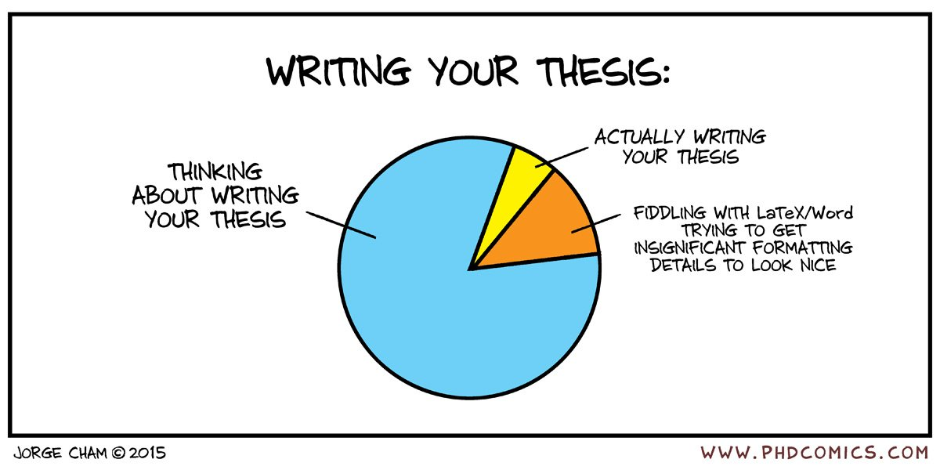
How to Be a Qualified PhD?
Be self-motivated. Time flies!

Slide 26
How to Be a Qualified PhD?
Conduct research independently.
Seek for knowledge and solutions independently.
DO NOT wait for your supervisors and seniors to give good ideas/pass good papers/pass good tutorials to you.
It is good to talk with your friends/group mates/lab mates/roommates/classmates (I believe at least one of them is doing PhD as well). Learn something from their research habits and experience.
This is the most important ability of PhD.

Slide 27
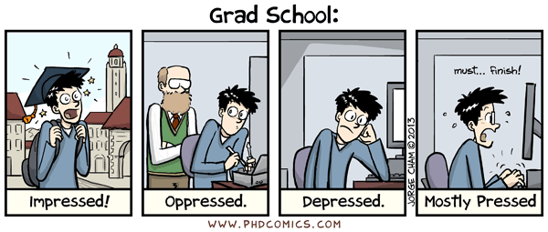
How to Be a Qualified PhD?
Most people will come across bad moments/failures/depression during the PhD journey
This is common and normal! Because doing research (and handling a lot of non-research issues such as courses/TA duties/projects at the same time) is not easy.
Your health and happiness are always the most important thing.

Slide 28
Plagiarism
This is a very important issue, which is strongly related to the reputation of your supervisor and every group member.

Slide 29
Plagiarism (Defined from ACM Society)
Different societies have different policies. But most of them are similar. We take the policies from ACM as an example here.
Level I - Incidental violation:
Verbatim copying of small portions (less than 2 sentences) of another author's paper with citing, but not clearly differentiating what text has been copied (e.g., not applying quotation marks correctly),
Or not citing the source correctly,
Or self-plagiarism/redundant publication, if there are citations but they are poorly placed or misleading
Penalty:
Write a letter of apology to parties (e.g., editors, authors of prior works, co-authors) identified during the investigation, including an admission of wrong-doing.
Published items in the ACM Digital Library will be updated with a corrigendum noting the reasons for change and addressing the issue. Unpublished items will be rejected without further review.

Slide 30
Plagiarism (Defined from ACM Society)
Level II - Low-level violation:
Verbatim copying of small portions (more than 3 sentences) of another author's paper with citing, but not clearly differentiating what text has been copied (e.g., not applying quotation marks correctly),
Or not citing the source correctly,
Or self-plagiarism/redundant publication, without citations
Penalty :
Write a letter of apology to parties (e.g., editors, authors of prior works, co-authors) identified during the investigation, including an admission of wrong-doing.
Published items in the ACM Digital Library will be withdrawn. Unpublished items will be rejected without further review.

Slide 31
Plagiarism (Defined from ACM Society)
Level III - Moderate violation:
Verbatim copying,
Or near-verbatim copying,
Or purposely paraphrasing several elements of another author‘s work,
Or copying elements of another author's work without citing the sources or without clearly delineating the source material
Penalty:
Write a letter of apology to parties (e.g., editors, authors of prior works, co-authors) identified during the investigation, including an admission of wrong-doing.
Published items in the ACM Digital Library will be withdrawn. Unpublished items will be rejected without further review.
Banned from contributing to any related ACM Venue for a full calendar year.
A letter explaining the violation, findings, and penalties will be sent to the Dean, chair, or supervisor of each party found in violation.

Slide 32
Plagiarism (Defined from ACM Society)
Level IV - Significant violation:
Verbatim copying,
Or near-verbatim copying,
Or purposely paraphrasing a significant portion of another author's work without citing the sources and without clearly delineating the source material
Penalty:
Write a letter of apology to parties (e.g., editors, authors of prior works, co-authors) identified during the investigation, including an admission of wrong-doing.
Published items in the ACM Digital Library will be withdrawn. Unpublished items will be rejected without further review.
Banned from submission to any ACM Venue for the next two years.
A letter explaining the violation, findings, and penalties will be sent to the Dean, chair, or supervisor of each party found in violation.

Slide 33
Plagiarism (Defined from ACM Society)
Level V - Severe violation:
Repeated violations (contains two or more violations mentioned above)
Penalty:
Write a letter of apology to parties (e.g., editors, authors of prior works, co-authors) identified during the investigation, including an admission of wrong-doing.
Published items in the ACM Digital Library will be withdrawn. Unpublished items will be rejected without further review.
Banned from submission to any ACM Venue for the next five years.
The case and evidence will be forward to the ACM Committee on Professional Ethics for consideration.
A letter explaining the violation, findings, and penalties will be sent to the Dean, chair, or supervisor of each party found in violation.

Slide 34
Plagiarism
Policies:
ACM (applicable to SIGMOD, KDD…) https://www.acm.org/publications/policies/plagiarism-overview
IEEE (applicable to ICDE, ICDM…) https://www.acm.org/publications/policies/plagiarism-overview Section 8.2.4d, Page 105
VLDB https://www.vldb.org/pvldb/policies.html
Please attend PDEV6770 seriously. There are sessions such as Publication Ethics, Academic Integrity & Intellectual Property, and Research Ethics Case Studies. Most of these sessions are compulsory for all HKUST RPG students. The contents include (but not limited to):
Judging What is Plagiarism & How to Avoid It
Differences between Plagiarism and Copyright Violation
Hong Kong Copyright Law and Legitimate Use and Fair Dealing
HKUST Intellectual Property Policies
Please keep everything you have learned in mind.

Slide 35
Plagiarism – How to Avoid?
Conclusions:
Cite EVERY paper and material you refer to during your writing/coding properly.
DO NOT USE DIRECT QUOTES From Published Material: In 99.99% of the cases, the information you want from a research article is an objective result or interpretation. How the author stated this information, i.e., their prose, is of little importance compared to the results or interpretations themselves. Take the information and put it into your own words; avoid paraphrasing since this can potentially lead to plagiarism.
Draw EVERY component in the figures BY YOURSELF. DO NOT CROP others’ figures.
If a theorem is already proved in another work, cite that work and use the theorem. DO NOT write the proof again.
DO NOT copy anything from your previous papers or any paper of your coauthors. This is self-plagiarism. All the penalties apply to self-plagiarism.
DO NOT ask questions such as “I think this paper has also copied something from that paper, why it is not punished?”. Others are idiots does not mean that you also have to be an idiot.
A paper will be related with the reputation of you and your coauthors for a whole life time. DO NOT take any risk.

Slide 36
Plagiarism – Our Tool
This is NOT a free tool. Every account has a limit of pages and words for checking. Therefore, it is not possible to check one work for many times.
We use iThentical for Plagiarism Checking in our group
https://www.ithenticate.com/products
Prof. Chen has an account of this tool that can help to use this tool for checking the papers and proposals submitted from our group.
Usage Guideline:
In 1 or 2 days (at least 24 hours) before your submission, please send your PDF version of draft to Sherry (via email or wechat) .
It will be definitely better to send the almost-ready version (need to include every section, especially the abstract and conclusion part).
The generation of report takes some time. DO NOT use the tool just a few hours before the deadline. If there is any problem, you still have time to save it.
Since there is a page limit of the account, every work can be checked for 1-2 times.

Slide 37
Wish You All The Best in Your Research Path
I sincerely acknowledge all the collaborators of my previous works and my group members for sharing their good research habits and experience with me.
I also acknowledge my friends, Richard, Rongxin, Yepang, Ying, and Guangneng, for sharing their common knowledge of research with me. ☺
Feel free to share your comments and knowledge in the slides!

